Slide 1
Exercise: What to include as metadata

Slide 2
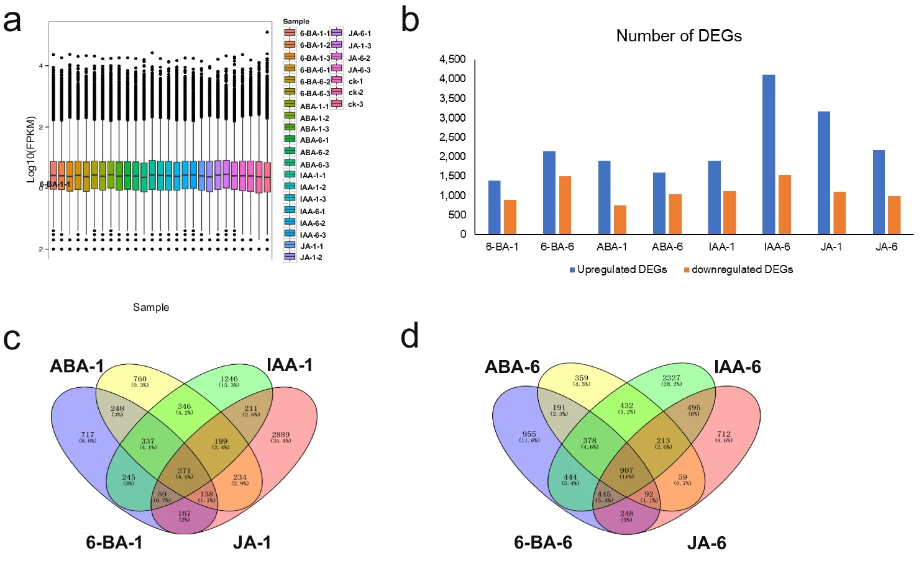
Example 1
Answers:
Organism: species, genotype
Growth conditions: temperature, light, treatments (phytohormomes – chemical list, concentration used, at what stage it was applied)
Sample: Time of sample collection, which part of the organism was collected
Transcriptome: protocols (RNA extraction, sequencing library preparation, sequencing platform)
Data analysis: how was raw data processed- software, scripts, how were the DEGs determined, what was the screening criteria, how were diagrams created?
https://doi.org/10.1038/s41597-024-03119-0
Notes:
Meng, C., Peng, X., Zhang, Y. et al. Transcriptomic profiling of Poa pratensis L. under treatment of various phytohormones. Sci Data 11, 297 (2024).

Slide 3
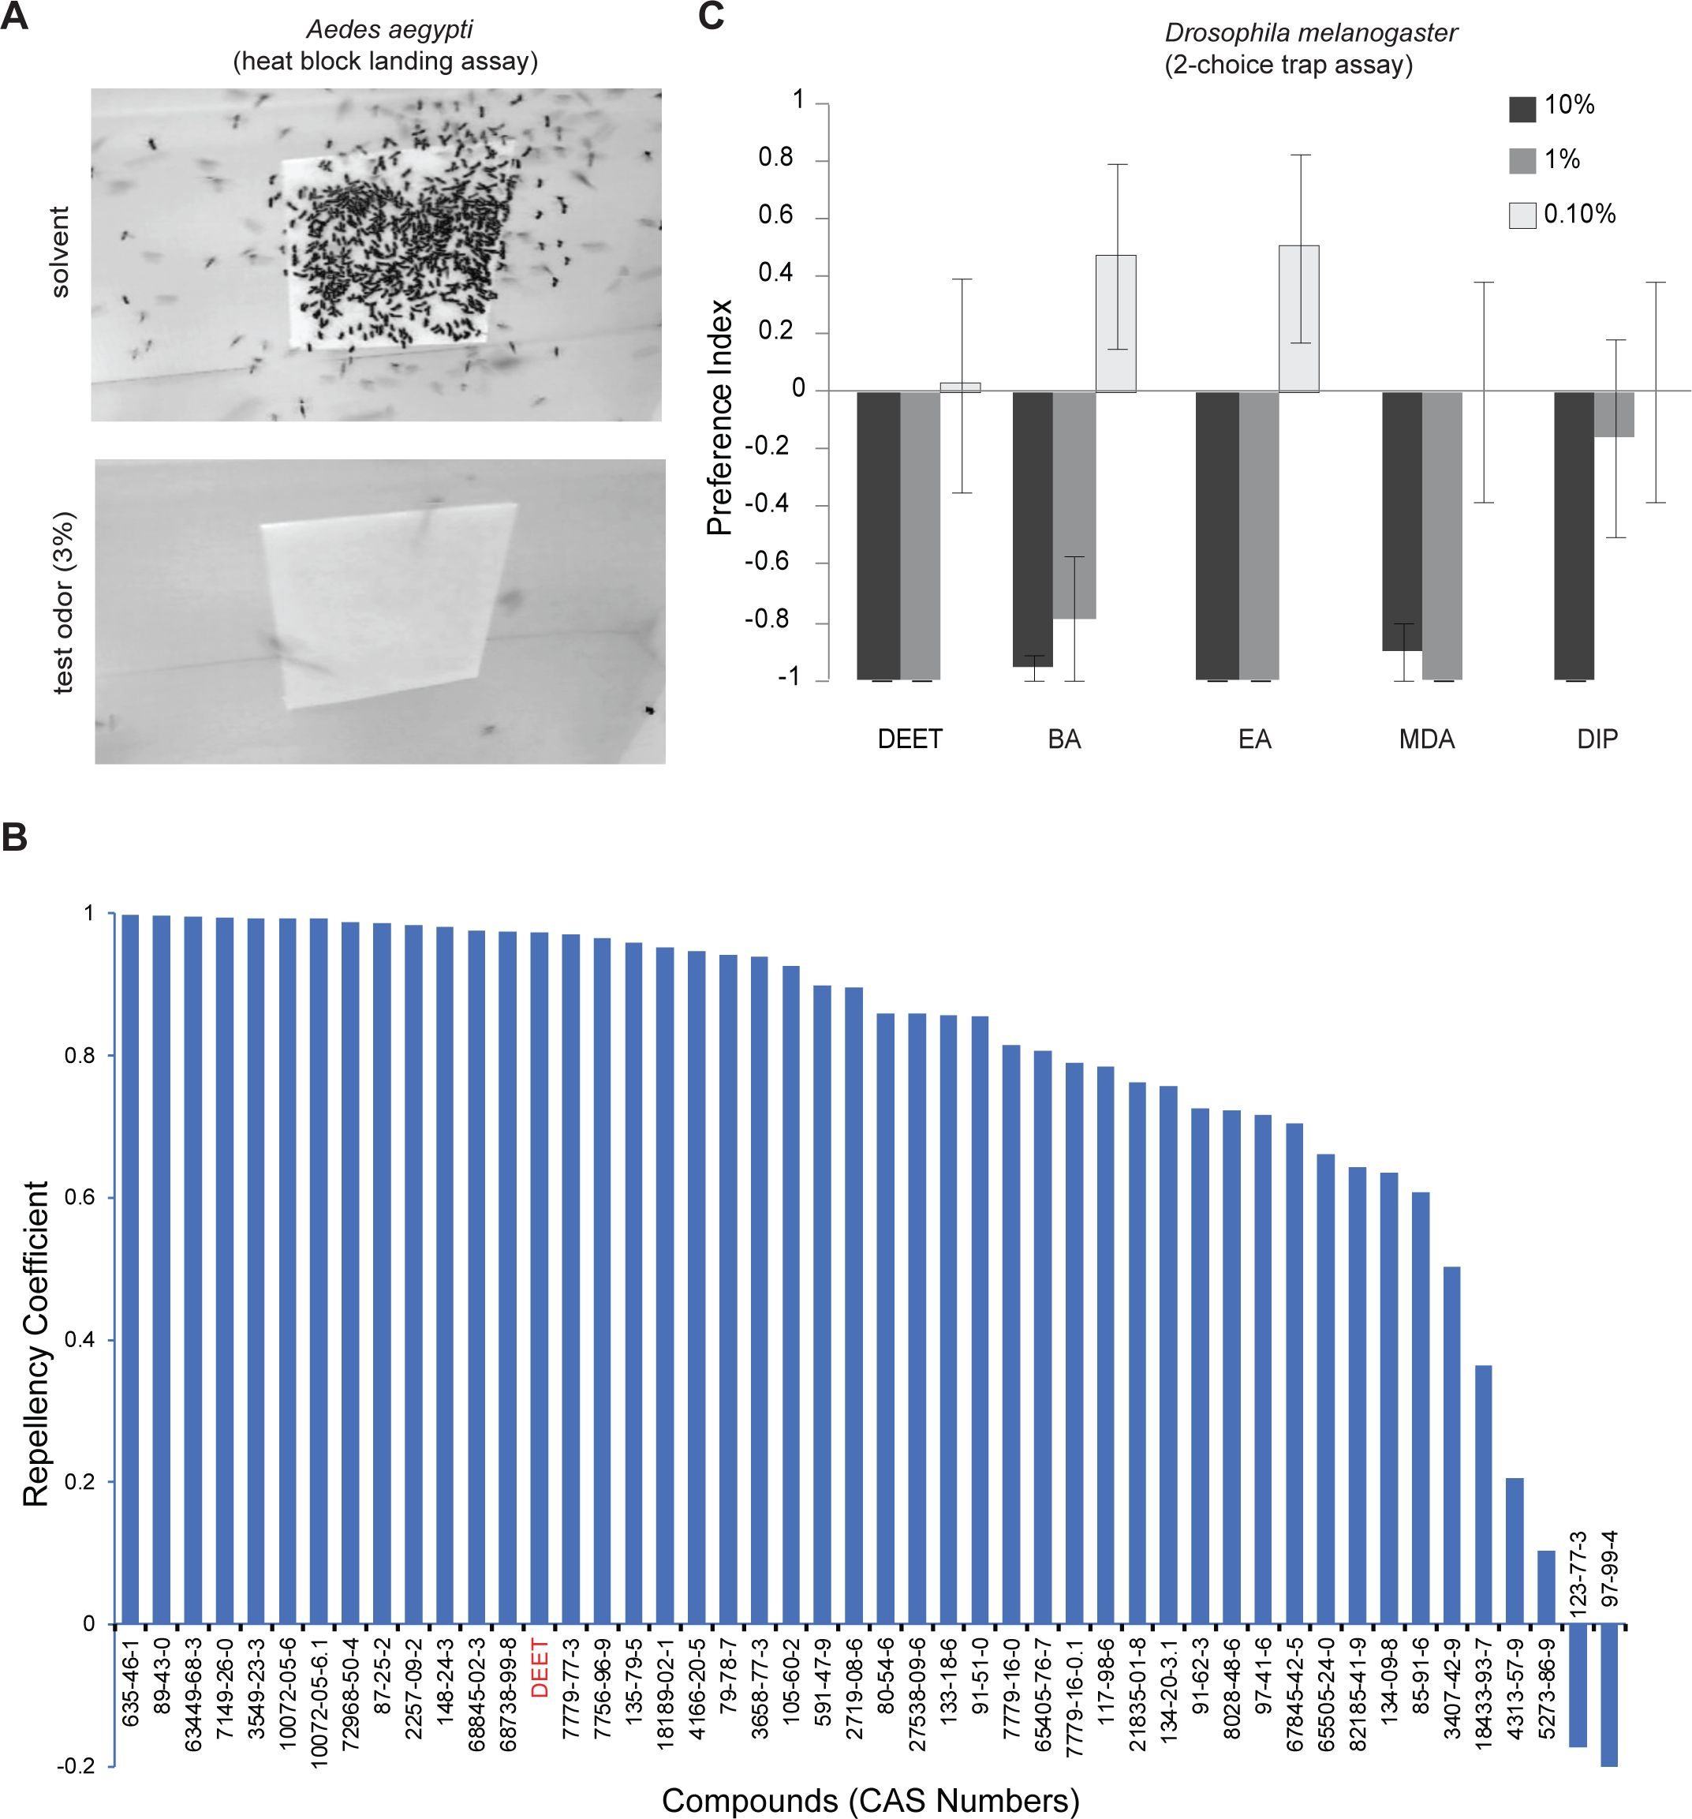
Example 2
Answers:
Organism: species, sex
Growth conditions: temperature, humidity, feeding
Description of the devices:
traps or heatblock: how are they made, list of materials, temperature of heatblock
Tests: how many flies/ mosquitos per test, how long, counting (manually or automated), what is the solvent and test odour.
List of compounds
Data analysis: how is the repellent coefficient calculated, bars are SE or SD, how many reps?
https://doi.org/10.7554/eLife.95532.1
Notes:
https://elifesciences.org/reviewed-preprints/95532/figures#tab-content

Slide 4
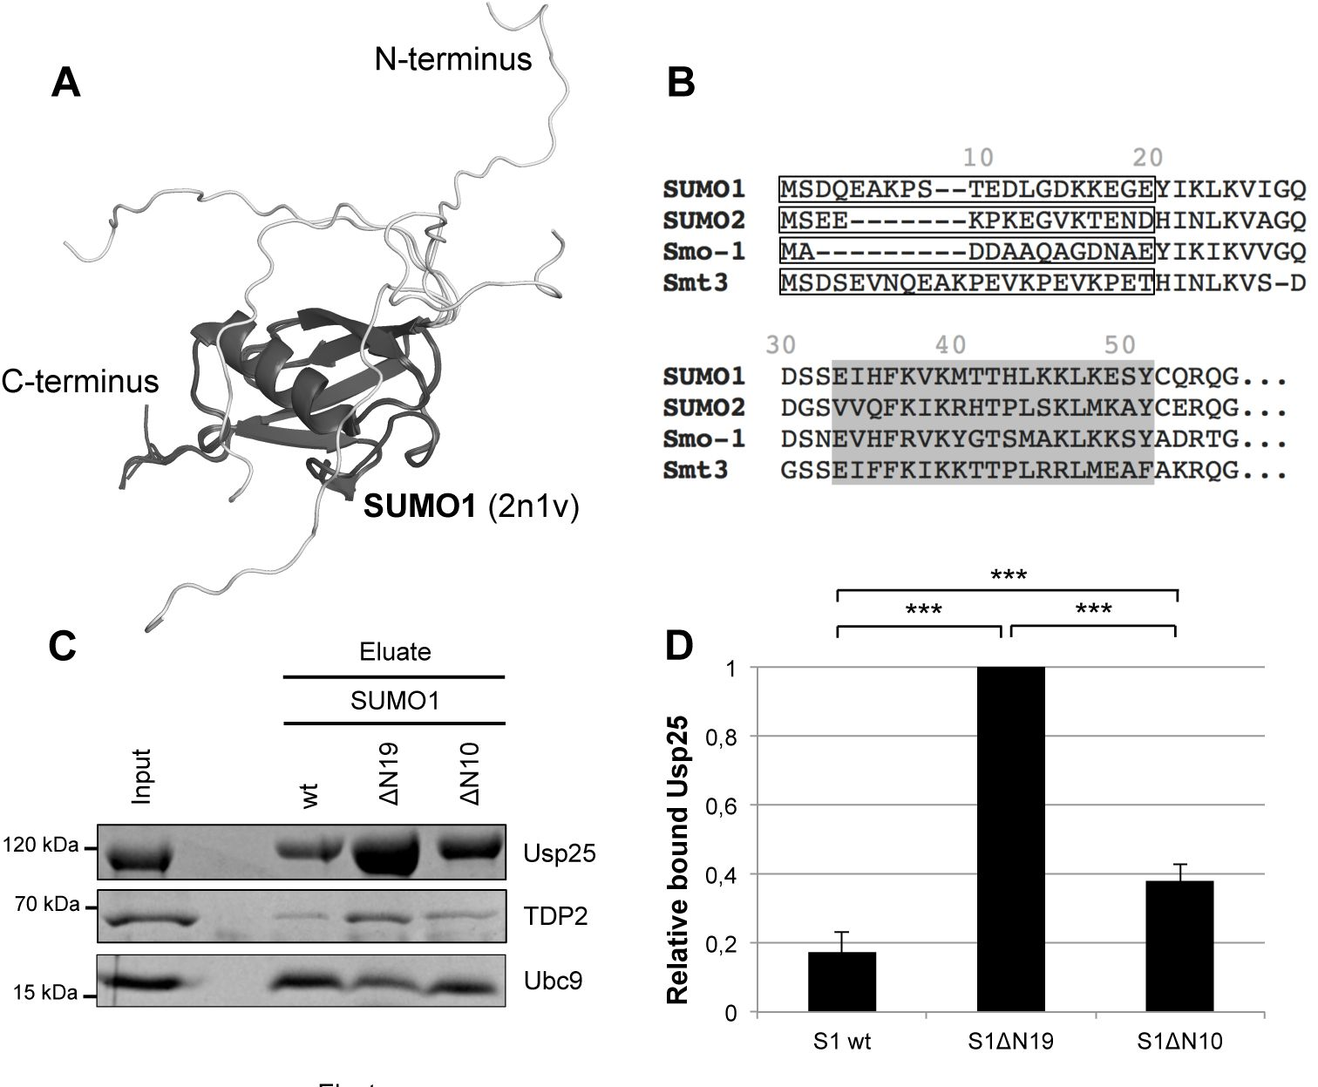
Example 3
Answers:
Sample: how was the protein obtained?
(amplified from a plasmid construct? Which ones)
from which organismare the protein sequences, how the structure was rendered
List of protein sequence sources (accession numbers)
Protein alignment: software used, what is being highlighted and why
Protocols for protein expression and purification
SDS page protocol: reagents, buffer, gel staining
experimental context (what are they trying to find – in this case “o test whether SUMO’s disordered N-terminus prevents protein interactions” by testing mutants with binding partners (USP25, TDP2 etc).
list of samples used (wilt type, mutants)
Data analysis: How is relative bound calculated, number of replicates, statistical test used, p values that asterisks indicate
https://doi.org/10.7554/eLife.95313.1
Notes:
https://elifesciences.org/reviewed-preprints/95313

Slide 5
Example 4
Answers:
Organism: species, genotype, sex, age
Growth conditions: temperature, feeding, light regimen, entrainment, treatments
Meaning of the bars under X axis
Protocols: How sleep was measured, device description
Data analysis: statistical test used, number of replicates, how is FRET calculated
https://doi.org/10.1371/journal.pbio.3001324

